Slide 1
Cross Platform Charting
Brian Becker (16 August 2018)

Slide 2
Overview
Examine two cross-platform charting options available with Dyalog APL
  SharpPlot
    Available since 2005 (its roots date back much earlier to RainPro)
    Originally developed by Adrian Smith
      As a .NET assembly with an APL interface
    Nicolas Delcros took over development in 2014
      Produced a version that can run on other platforms
  Syncfusion Essential JavaScript I
    Available with MiServer since 2013
    WC2 interface
      Runs under HTMLRenderer and/or MiServer

Slide 3
Cross-Platform
Cross-Platform = any platform where Dyalog runs
  Windows, macOS, Linux, AIX
Cross-Platform may be important to you if you…
  develop on a platform other than Windows
  develop on Windows but deploy elsewhere
  distribute a product to run on multiple platforms
  want to provide an interface on the net
Same code on all platforms
  Write once, run everywhere

Slide 4
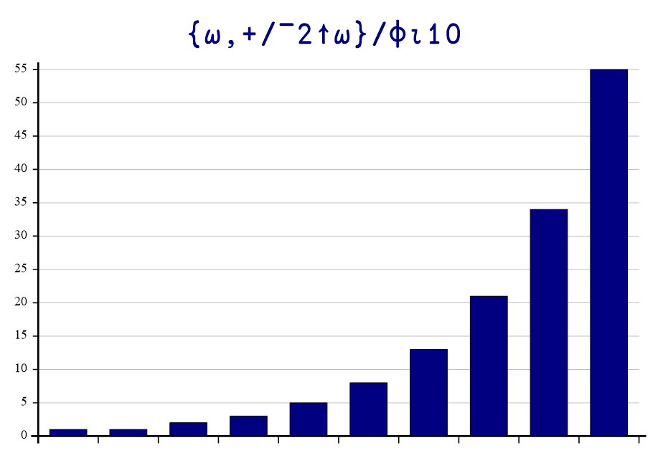
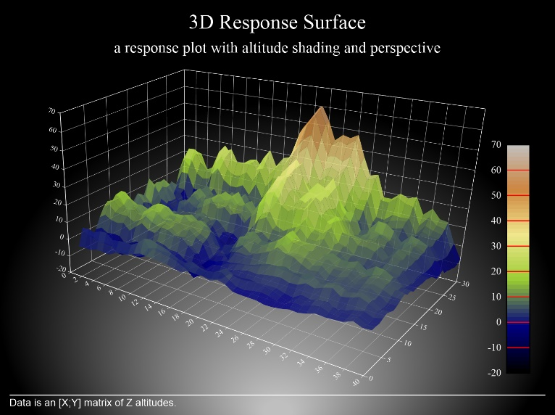
Charting
Data visualization
How is it going to be used?
  Interactive?
    Dynamically generated?
    Animated on generation?
    Responsive to user interaction?
  Static?
    Print or electronic publication (e.g. PDF)?

Slide 5
Today's Goals
Goals
  Make you aware of the "off-the-shelf" options available with Dyalog
  Supply enough information for you to start exploring
Non-goals
  Teach you the details of SharpPlot or Syncfusion
    Either could easily fill a full day workshop (or more)
  Recommend one solution or the other
    It really depends on your needs

Slide 6
Environment
Today's demonstrations will be
  Geared toward interactive use, not static publication
  Using MiServer and WC2
    WC2 is a Dyalog framework for generating HTML/CSS/JavaScript
    Later this year WC2 will be split out on its own
    to provide a common framework for delivering
    desktop applications using HTMLRenderer
    and networked applications using MiServer

Slide 7
A tale of two pies…
Develop 2 similar pie charts under each of SharpPlot and Syncfusion
  Start simple
  Build a page
  Add a minimal chart
  Render
  Enhance

Slide 8
Demo Time
Demo Pies

Slide 9
SharpPlot
Windows users have an advantage when using SharpPlot
  The Chart Wizard provides an interactive chart designer (the resulting code will run on any platform)
  The SharpPlot engine is compiled into C# and renders some charts significantly faster
SharpPlot generates output in a variety of standard format
  SVG, PDF, PostScript
  These can be used on other platforms or incorporated into documents
Our approach for today is to generate SVG which can be
  rendered by HTMLRenderer (locally)
  rendered by MiServer (network)
  saved as a file and then included in an HTML page or document

Slide 10
Demo Time
Demo SharpPlot and Chart Wizard

Slide 11
SharpPlot C#/APL Syntax
C# | APL (WC2)
SharpPlot sp = new SharpPlot() | sp←⎕NEW Causeway.SharpPlot
sp.Heading="Hi!" | sp.Heading←'Hi!'
sp.KeyStyles=KeyStyles.Center|KeyStyles.Bottom | sp.KeyStyles←Causeway.KeyStyles.(Center+Bottom)
sp.DrawPieChart(data pie) | sp.DrawPieChart(data pie)
sp.SetKeyText(key) | sp.SetKeyText ⊂key

Slide 12
Demo Time
Syncfusion Demos

Slide 13
Syncfusion JavaScript/APL Syntax
Language | Syntax
JavaScript | series: [ { marker: { datalabel: { visible: true, shape: 'none'
APL/WC2 | 'series[1].marker.datalabel.(visible shape)' myChart.Set _true 'none'

Slide 14
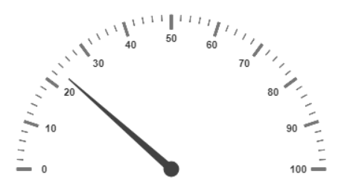
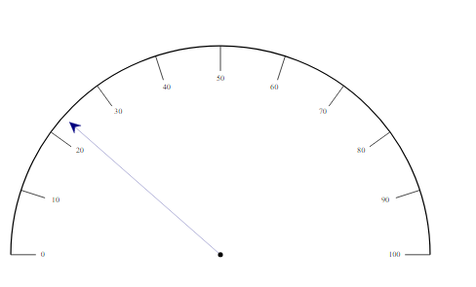
Chart Variety
SharpPlot
  23 chart types (3 are 3D)
Syncfusion
  28 chart types (8 can be 3D)
  16 other data visualization controls
  some of which correspond to SharpPlot
  chart types

Slide 15
SharpPlot Resources
https://www.sharpplot.com
Tutorials, Chart Samples, and Reference
Examples are in C#
  Translating to APL is straightforward
Chart Wizard (Windows only)
(for now)

Slide 16
Syncfusion Resources
https://help.syncfusion.com/js – API reference
Extensive demos with use cases - http://js.syncfusion.com/demos/web/
Examples are in JavaScript
  Translation to APL is straightforward
WC2 examples - https://miserver.dyalog.com

Slide 17
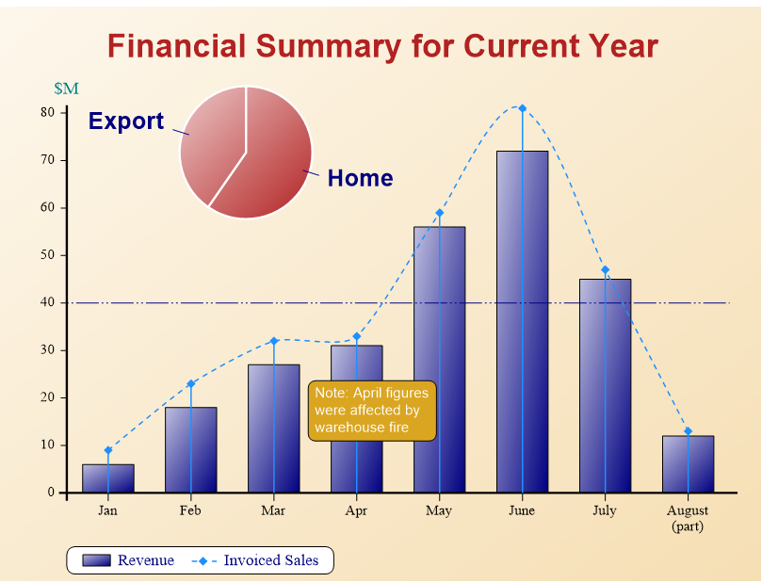
Interactivity and Layout
SharpPlot
  Interactive, not animated
  Extensive layout control
  Part of Dyalog (nothing to download)
  Can be run standalone and generate output for publication
Syncfusion
  Interactivity on many charts
  Themed styling, Localization
  Layout control is good
  Part of MiServer/WC2 (needs to be downloaded)

Slide 18
In Conclusion
Both SharpPlot and Syncfusion are capable of
  producing a wide variety of quality, highly customizable, charts
  animation and interaction with the user
SharpPlot is good
  For print or publication media (doesn't need a web server framework)
  If you need fine control over layout
Syncfusion is good
  For web dashboards and applications
It's not an either/or choice
  You can use both!

Slide 19
Thank you!
Follow up sessions?
  Email: brian@dyalog.com
Questions?

Slide 20
Upcoming Webinars
Please suggest topics for webinars and web casts!
September 20th:
  Jupyter Notebooks (Adám Brudzewsky)
There will not be an October webinar.
  We'll be at Dyalog'18 in Belfast! ☺
    Some presentations will be streamed live.
    Video recordings of presentations will be
    online in the weeks following.

